Slide 1
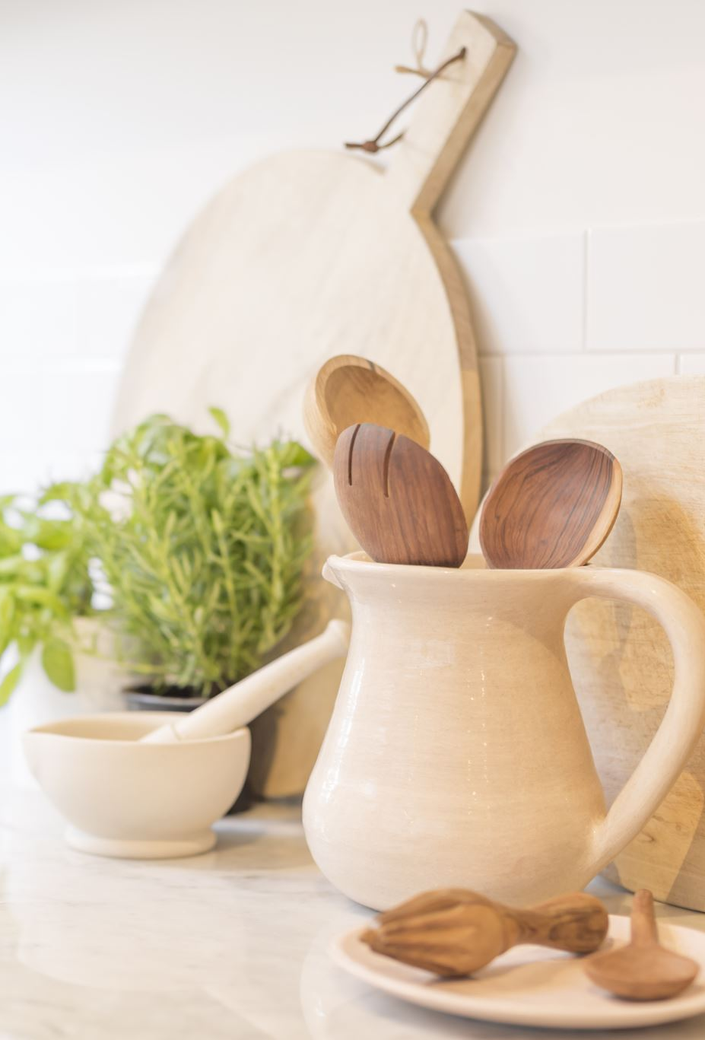
My kitchen companion 🍪
Nitay Suissa, Matan Solomon

Slide 2
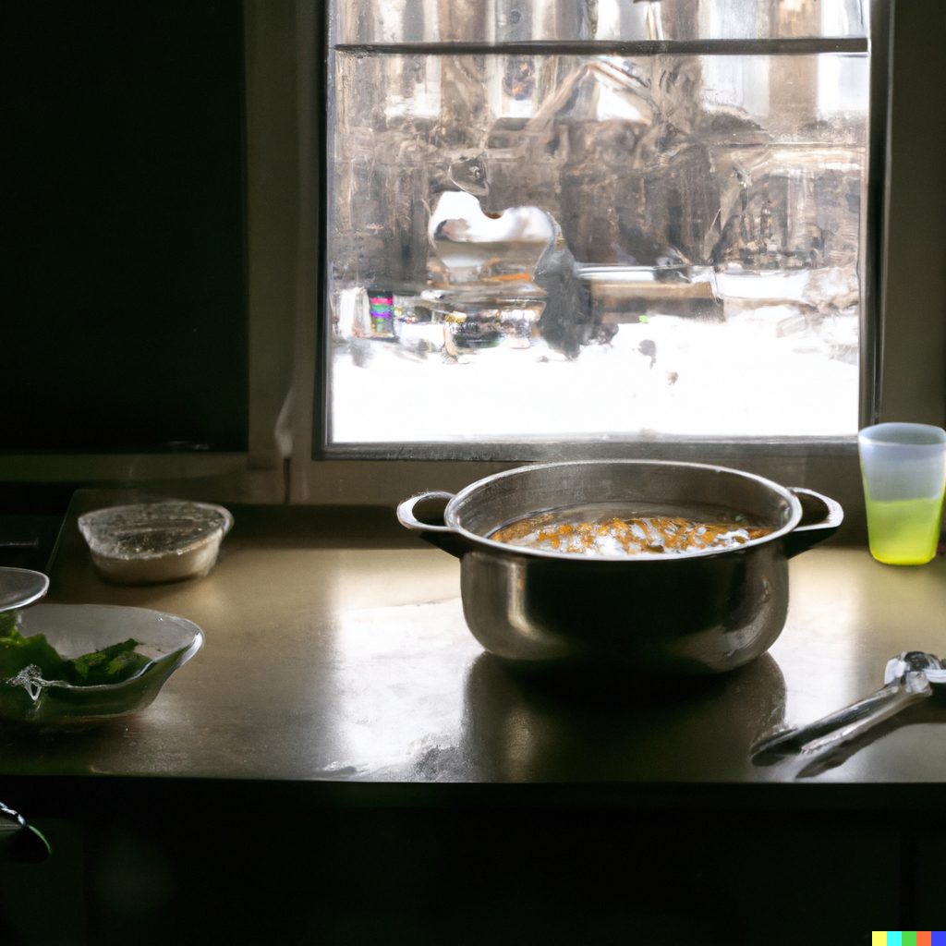
Motivation
Notes:
It’s Wednesday, another long, exhausting workday, yet you can already smell the weekend you’re so waiting for. You had a long day at work, and you are finally home, ready to make dinner, take a shower and go to sleep. Every day, when you arrive home, busy and bothered with the daily stuff, you make yourself the same simple, quite boring dinner - probably an egg in some form, slices of bread, and so on. Today, you want to make something different, interesting, or special, to relieve the weekly boredom of your same daily dinner. You open a recipe book and look for something interesting. You want something salty, baked but yet quick, oh, and you’re out of eggs. Reviewing the long recipes book gave you nothing. If you only had an Intelligent Interactive System that you could intuitively tell it what you want and what you have, and it would retrieve the perfect thing for you...

Slide 3

Interface tasks
Capture our abstract intuition
Translate it into concrete properties
Retrieve the appropriate recipe
Support online adjustments
My kitchen
companion🍪

Slide 4
Our approach
Embedding
Retrieval

Slide 5
Our approach embedding
Initial representation
Graph neural network
Embedding
Recipe1M+

Slide 6
Our approach Retrieval
Receive input
Feature representation
Retrieval

Slide 7
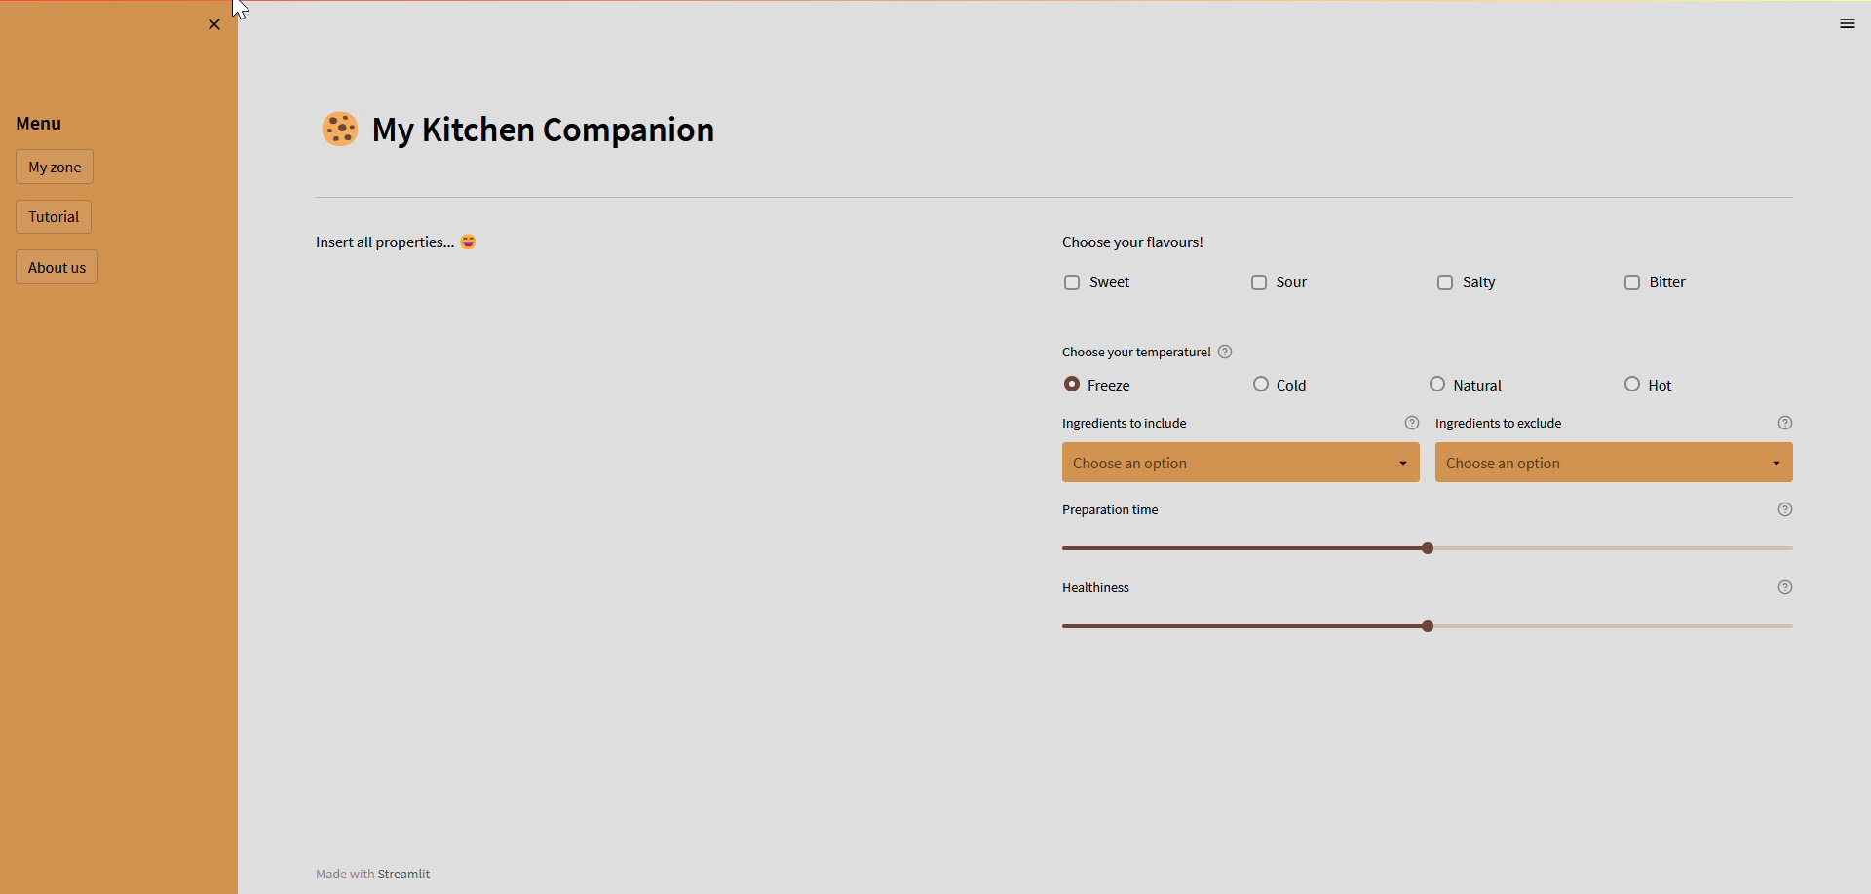
prototype

Slide 8
THANK YOU

